Slide 1

Find the Influential Node of a Dynamic Graph
Ranojoy Barua (510515025)
Guided by : Prof. Susanta Chakraborty

Slide 2
Motivation
Huge amount data are generated each day on social-media.
This project aims to represent social media on graph.
This project aims to find the most influential road in a given graph made from data-set of read network of California.

Slide 3
Introduction
This project aims to find the most influential node in a graph.
Various parameters are calculated based on which a set of most favorable nodes are selected.
Edge list representation of the graph is used during the project.

Slide 4
Objective
Representing a graph in edge list.
Find most influential road in a dynamic graph by calculating parameters like:
1) Freeman’s degree centrality
2) CC value
3) Enhanced degree centrality

Slide 5
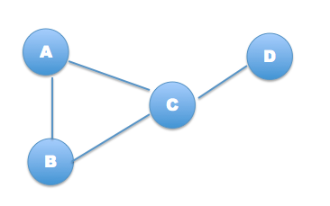
Preliminary
Representing a graphs by using edge list.
A | B | C
B | A | C
C | A | B | D
D | C

Slide 6
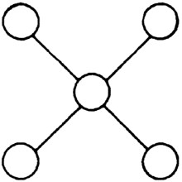
Preliminary
Influential node : Node that is well connected through out the graph.
Node in the center is
the most influential node.
Social media : Online communications channels dedicated to community-based interaction, content-sharing and collaboration.

Slide 7

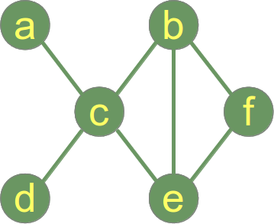
Method
1) Clustering coefficient (CC value)
It is a measure of the degree to which nodes in a graph tend to cluster together.
CC(e) = 2/3
Numerator is 2 of the presence of the two edges b-c, b-f.
Denominator is 3 because all total three edges can be formed in between nodes c, b and f i.e., b-c, b-f and c-f.

Slide 8

Method
2) Freeman's degree centrality
Measures the connectivity of a given node with its neighbor.
FDC(e) = 3/2
Numerator is 3 because 3*(4-3) i.e., (Degree of current node)*(Max. degree of node in total graph – degree of current node).
Denominator is 2 because
|(3-4)| + |(3-3)| + |(3-2)|

Slide 9
Method
3) Enhanced degree centrality
Product of CC value and Freeman's degree centrality. It measures the connectivity of the nodes connected to a given node.
EDC(e) = CC(e) * FDC(e)
EDC(e) = (2/3)*(3/2)
EDC(e) = 1

Slide 10
Method
Calculate all three above mentions parameters and sort in ascending order with respect to the each parameter independently.
Add rank of all the parameters for each node.
The node with smallest aggregate rank is most influential node.
Find the co-ordinates of the most influential node from data-set.
Plot it in world-map.

Slide 11
Calculating Parameters (Graph Representation)
The graph at the instance selected by the user is a static graph.
e.g. a c b e e f f b
d c b f c a f e
b c e b c b
e c c d c e
Edge list is used to store the graph in memory.
e.g. a c
b c e f
c a b d e
d c
e c b f
f b e

Slide 12
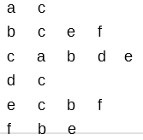
Calculating Parameters (CC value)
To calculate CC value of a node total number of edges among neighbors is divided by the possible number of edges in between the neighbors.
e.g. In this graph we find the CC value of node b
Select the total record for node b.
i.e., b c e f
Check all the possible edges that may exist in between the neighbors of node-b i.e., check does edge
c-e, c-f, e-c, e-f, f-c and f-e
exist and if exist count how many of them exist.

Slide 13
Calculating Parameters (CC value)
In this graph for node-b only c-e, e-c, e-f and f-e exis i.e., 4 edges.
Now divide this number by 2 as edge A-B is equal to edge B-A.
Total possible edges between neighbours is calculate using formula
total_possible_edges = n*(n-1) / 2
For node-b total possible edges is 3*(3-1)/2 which is equal to 3.
So CC value for node-b is 2/3 = 0.667 i.e.,
(total_edges_exist_among_neighbours / total_possible_edges_among_neighbours)

Slide 14

Calculating Parameters (Freeman’s Degree Centrality)
To calculate freeman’s degree centrality of a node-x total difference of degree of node with maximum degree to all of the neighboring nodes of node-x is divided by the total difference of degree of node-x to the degree of neighbouring nodes.
i.e.

Slide 15

Calculating Parameters (Freeman’s Degree Centrality)
Node with maximum degree is node-c i.e., 4.
To find freeman’s degree centrality of node-b first select the record starting with b
i.e., b c e f
Now to calculate the value of numerator (a) find sum of all the difference between degree of node-b and neighbouring nodes of b i.e.,( c, e, f )

Slide 16
Calculating Parameters (Freeman’s Degree Centrality)
Degree of c, e and f are 4, 3 and 2 respectively.
So, a = |(3-4)| + |(3-3)| + |(3-2)| = 2
Similarly to calculate the value of denominator (b) find sum of all the difference between maximum degree of node in graph and neighbouring nodes of b i.e.,( c, e, f )
As node-c have maximum degree i.e., 4
So b = |(4-4)| + |(4-3)| + |(4-2)| = 3
So freeman’s degree centrality of node-b is 2/3 = 0.667

Slide 17
Calculating Parameters (Enhanced Degree Centrality)
Enhanced degree centrality of a node is calculated by multiplying the CC value and freeman’s degree centrality of a node.
To find the enhanced degree centrality of node b in this graph first CC and freeman’s degree centrality is calculated and then multiplied
So, enhanced degree centrality of node b is :
0.667*0.667 = 0.447
CC value of node-b = 0.667
Freeman’s degree centrality of node-b = 0.667

Slide 18

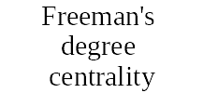
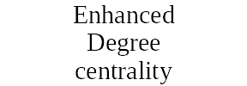
Selecting Most Influential Node
We have calculated four parameters on the social network.
Based on each parameter ranking is done individually, in this way there are total four rankings obtained.
Now for each node their individual ranking in these four parameters is added.
The nodes with least aggregate rank is known as the most influential node.
e.g. 3 1 4 1 6 1
2 2 6 2 4 2
5 3 1 3 3 3
6 4 5 4 1 4
4 5 3 5 2 5
1 6 2 6 5 6

Slide 19

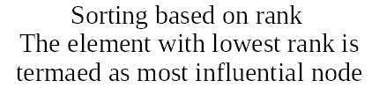
Selecting Most Influential Node
Aggregate sum of ranks :
1 14 6 9
2 16 4 12
3 15 1 14
4 12 3 15
5 18 2 16
6 9 5 18
If two or more nodes share the least ranking then all of them are the most influential node because their orientation, connectivity in the graph and connectivity among the neighbors is identical.

Slide 20
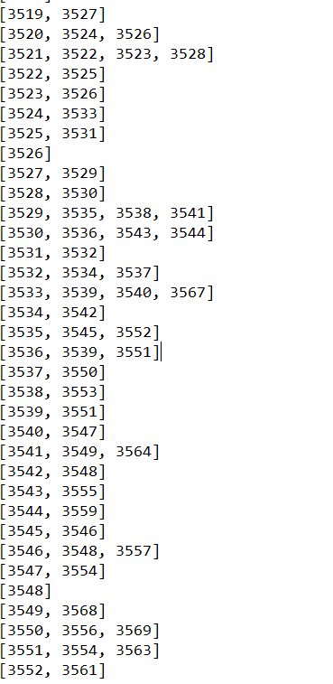
Experimental Result
Edge-list representation
of graph.

Slide 21
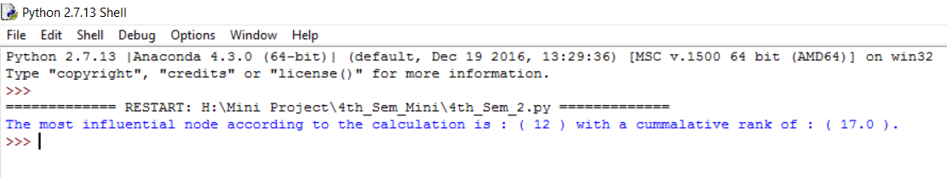
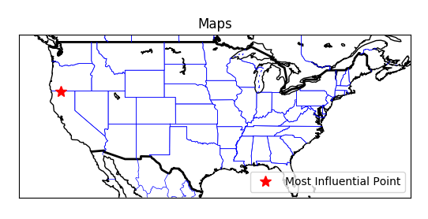
Experimental Result
Output obtained :
Plot in world-map :

Slide 22
Statistics
Total number of nodes : 3,641
Total number of edges : 82,143
Total time taken to process the data : 895.076 seconds
Name of dataset : Facebook_combined.txt
Source of dataset : https://snap.stanford.edu/data/egonets-Facebook.html

Slide 23
Software and Hard-ward Used
Programming Language : Python
Software Platform : Anaconda Python
Library used : ast, numpy, scipy, basemap, mathplotlib
Hardware : i7 processor, 8GB RAM

Slide 24
Links and References
[2] https://snap.stanford.edu/data/egonets-Facebook.html
Amedapu Srinivas, R. Leela Velusamy, “Identification of Influential Nodes from Social Networks based on Enhanced Degree Centrality Measure”, IEEE International Advance Computing Conference, 2015, pp. 1179-1184.
Agnieszka Rusinowska, Rudolf Berghammer, Harrie De Swart, Michel Grabisch, “Social networks: Prestige, centrality, and influence”. in: de Swart. (Ed.) RAMICS 2011, Springer, 2011, pp.22-39
Linton C. Freeman, “Centrality in Social Networks Conceptual Clarification”, Social Networks, vol. 1, Issue 3, 1978–1979, pp. 215-239.

Slide 25
Thank-You

